Slide 1
Helping IT achieve more successful
cloud and data center migrations

Slide 2

Discovery + Analytics
What Applications or Devices exist in my Environment?
How are my Applications integrated?
What is my resource Utilization?
Which are the chattiest servers?
Where are devices and applications located?
What are my Bandwidth requirements?
What problems exist in my environment?
What are the low hanging fruits for optimization?
What is the business case for change?

Slide 3
Three Stages of Data Collection
How We Collect?
Discovery
ICMP Sweep (Covers Only Opt-In Subnets)
Select Port Scans
Match Credentials With Devices (Credentials Input During bootstrap)
All devices that respond to ping and are successfully accessed via the credentials are considering "Interesting Devices."
Inventory
Revisits Interesting Devices
Gather Workload Specific Data(Windows OS Vs. , Linux Vs. , VM , Etc.)
Then user can then select devices within the licensing page that will move on to the Performance Stage
Performance
Collect Ongoing Dependency and Performance Data(CPU Utilization , Disk Utilization , Network Utilization)
Continues Until Assessment is Ended

Slide 4
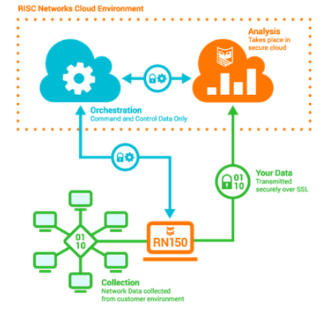
Components of Cloudscape
Virtual Appliance
Analytic Engine

Slide 5
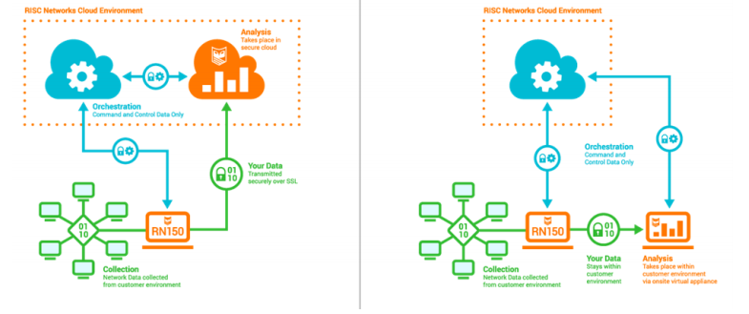
Deployment Models
SaaS Model
Flex Model

Slide 6
Bootstrapping RN-150
Create Assessment and obtain OVF file
Start SCAN
Spin Up Virtual Machine
Enter Credentials of Devices
Enter Bootstrap Key in Appliance
Enter Subnets to be Scanned
Set a Static IP for the Appliance
Login using HTTP/HTTPS via web portal

Slide 7
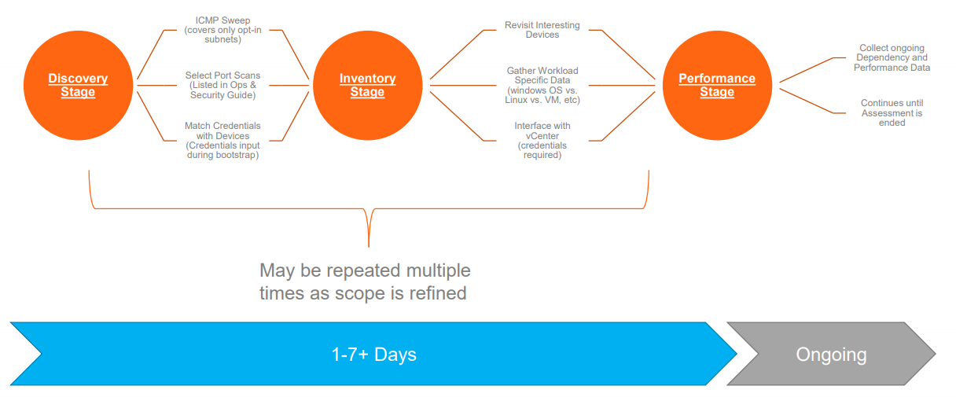
Cloudscape provides true picture of customer’s IT infrastructure by discovering the existing landscape and associated dependency matrix.
2 Weeks for Craft Phase
4 Weeks for Performance
2 Weeks for Discovery + Inventory

Slide 8


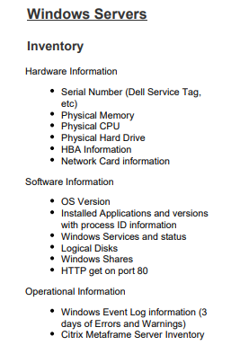
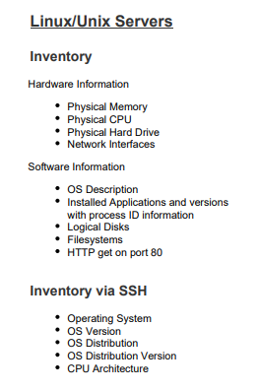
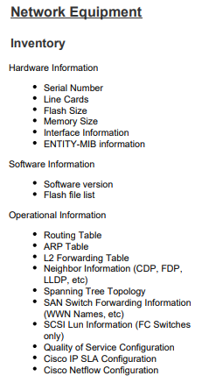
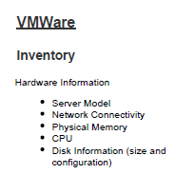
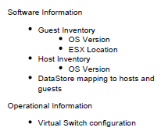

Slide 9




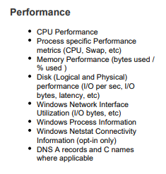
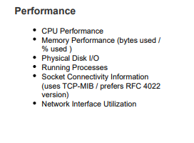
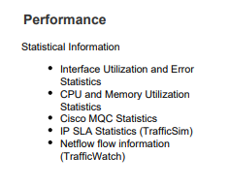
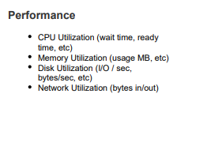

Slide 10

Deployment

Slide 11
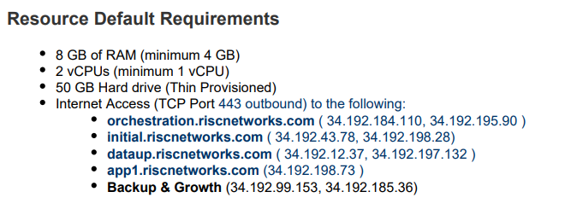
Prerequisites:-
Hardware Requirements for Deploying OVF Templates
For RN150 OVF
The RN150 is a CentOS/Linux Virtual Appliance. It is deployed on VMware ESX or ESXi Server (Hardware Ver. 8), VMware Player, or VMware Workstation.

Slide 12

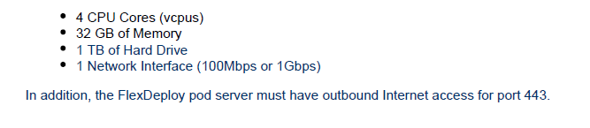
For Flex Deploy Pod
A Flex Deploy pod is instantiated by deploying an OVF file into the customer’s VMware infrastructure. RISC Networks FlexDeploy is only supported on VMWare ESXi 5.0 or higher.
Only orchestration, authentication, and licensing information is transmitted to the RISC Networks Secure Cloud Environment (SCE). All communication from the FDP to the RISC Networks SCE is handled via SSL Encrypted HTTPS web service calls. No inbound connectivity is required.
Log users into the appliance and verify their entitlement

Slide 13
Credentials
# No | Pre-requisites | Description
1 | Subnets | List of subnets in scope for discovery along with their location details.
2 | Windows Credentials | Required for discovery Windows machines which includes Desktops/ Server OS. Windows domain / local administrator credential for WMI access
3 | SSH Credentials | Required for discovery of Linux and Unix machines. User account with Sudo privileges. Password or Key based authentication.
4 | SNMP Read Only Credentials | Needed for Network Devices
5 | Database credentials | Required for discovery of database instances and database schema. User account, Password, Port Numbers, SID and IP address.
6 | vCenter credentials | Read only access to vCenter or root access to ESX host directly.
7 | Opening of TCP Ports | Refer next slide.

Slide 14
Protocols/Ports
Protocol | Port | Source | Destination | Usage
TCP | 443 | RN150 | Internet | For communication from the RN150 to the RISC Networks Cloud Orchestration layer
ICMP | — | RN150 | Local Networks | By the RN150 for base discovery for available devices
TCP | 135 | RN150 | Local Networks | By the RN150 to obtain WMI information from Windows hosts discovered
TCP | 1024-65535 | RN150 | Local Networks | RPC Dynamic Port Allocation used for WMI communication.
TCP | 80 | RN150 | Local Networks | By the RN150 to obtain HTTP
TCP | 443 | RN150 | Local Networks | Used for gathering VMware guest information directly from vCenter.
TCP | 22 | RN150 | Local Networks | By the RN150 to collect from Linux/UNIX servers over the SSH protocol
TCP | * | RN150 | Local Networks | Collection from Linux/UNIX servers via SSH user supplied non-standard TCP ports
TCP | 445 | RN150 | Local Networks | SMB over TCP/IP used for application socket collection
TCP | 139 | RN150 | Local Networks | SMB over NetBIOS used for application socket collection
TCP | 8443 | RN150 | Local Networks | Used for discovering Tomcat and Cisco UC servers*
UDP | 161 | RN150 | Local Networks | Used for gathering SNMP information from devices on the Network

Slide 15
Licensing
Licensing Types:-
Burst- This is a 30 day license of performance and dependency data collection. Once a burst has begun the relevant licensing is available for 30 days from start of the burst.
CCL (Continuous Collection License)- This is a license that is available for the life of the subscription. This allows the user to collect performance and dependency data at any time.

Slide 16
Building Application Stack

Slide 17
Application Stack
One of the primary goals for a discovery project is to organize all of the discovered (and licensed) workloads into the various Application Stacks This view supports more detailed planning and analysis for Strategic IT Planning, Cloud and Data-center migration, Security reviews, CMDB updates, and other use cases. Building Application Stacks is the process of reviewing and refining the automatically generated application stacks
How are App Stacks Built?
The RISC Networks Platform joins servers into groups based on the collected connectivity and process information. There are different group types the platform will create automatically

Slide 18
Application Stack
Group Definitions:-
RSG Groups (RISC Service Groups) - servers in these groups match an existing profile for the particular application group they are placed. (e.g. if we see a server running Microsoft Exchange Server and see it communicating via smtp it will be placed in the RSG-Microsoft Exchange Server)
AutoApp_XX Groups - Any device that does not match a predefined profile will be grouped into an AutoApp group based on its critical connectivity.
Isolated Devices- Devices in this group have had connectivity collected (there is an existing connectivity record where the specific device is either the source or destination of the connection), but none of the collected connections or processes would cause the specific server to join into an AutoApp or RSG Group.
No Connectivity- Any device where there is not an existing connectivity record where it is either the source or destination of the connection will end up in the No Connectivity group. (i.e. we do not have any connectivity to or from this device)
RSG-95th Highly Connected Stack- is the top 5% of hosts by connectivity in the network that are available to go into AutoApp_XX groups. In other words, it is the list of servers that talk the MOST that are not RSG eligible.
RSG-Out of Scope Services- IP addresses and / or device names will appear in this group if they are offering one of the following services: MSSQL, MySQL, oracle, NFS, or iSCSI, but are either not licensed, or their IP is out of scope (not included in the subnet ranges requested to be scanned).

Slide 19
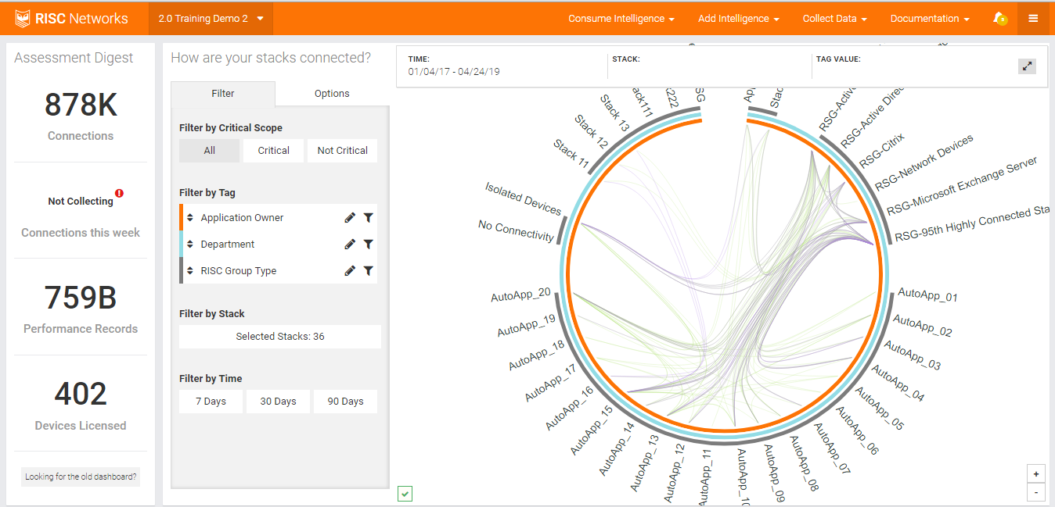
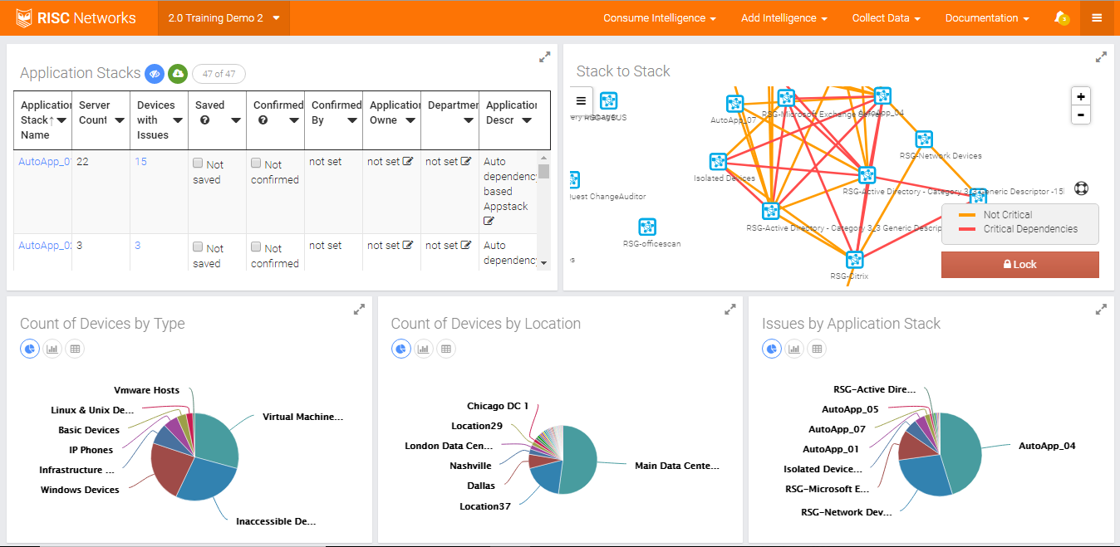
Dashboard at portal.riscnetworks.com

Slide 20
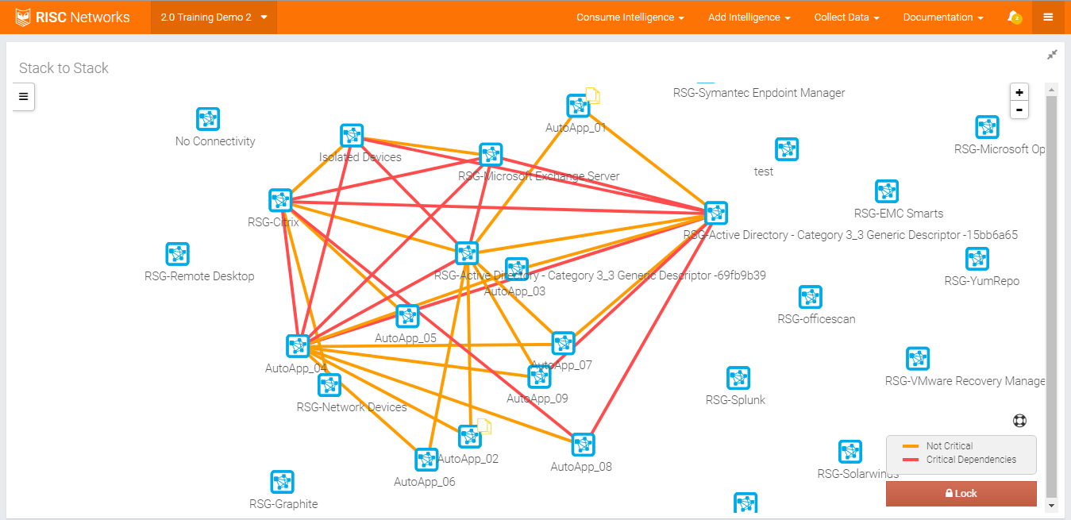

Slide 21
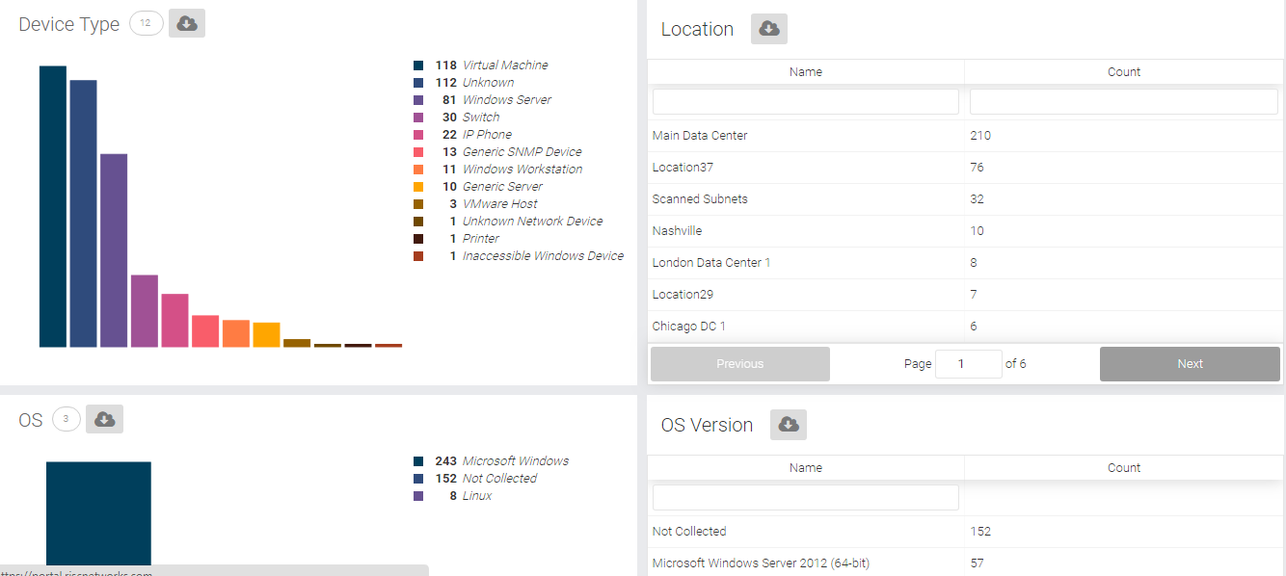
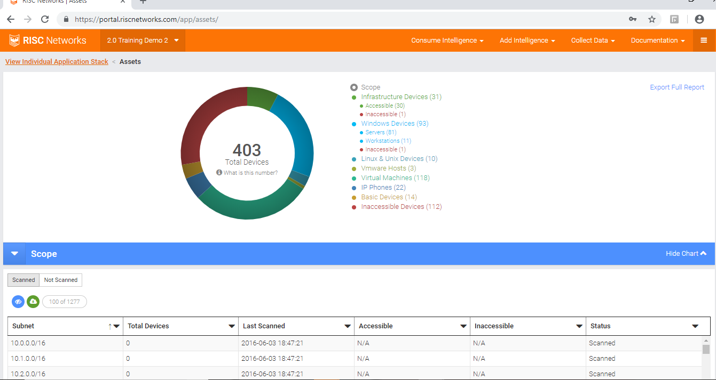
Full asset report :

Slide 22
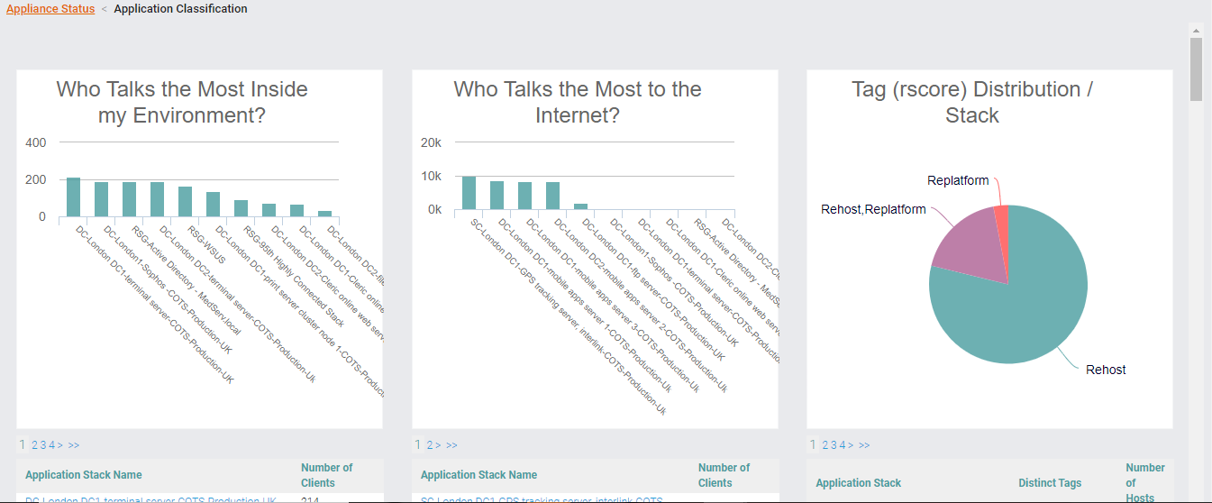
Application Classification (Internal & external dependencies + Treatment plan ). Further light analysis required to reach the final Assessment .

Slide 23
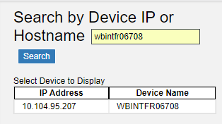
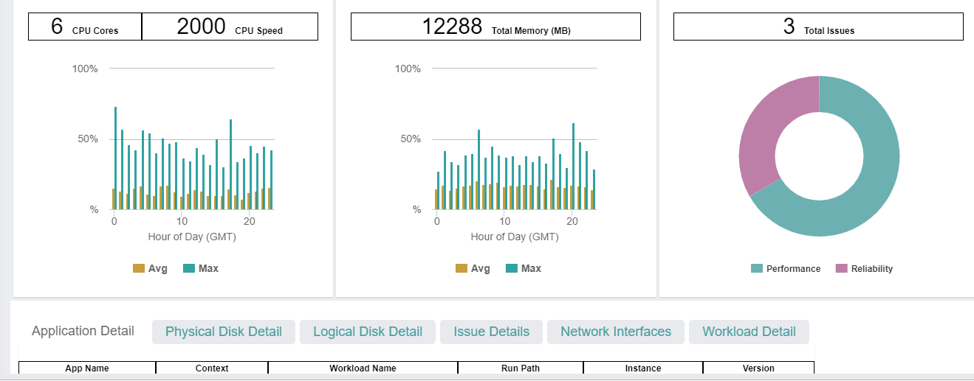
Device Details

Slide 24
Reports from cloudscape
Detailed application dependency data
Application stack process
Economics report
Private cloud resource requirement
Full Asset Report / Server Inventory Report
IAAS Cloud Pricing
TCO on premise

Slide 25
Thank You

Slide 26
Cloudscape Deliverables :
1. Full Asset report (i.e. how many servers RN150 can communicate with) Accessible & not accessible devices .
2. Application dependency mapping (server dependency both internal & external)
3. IAAS cloud pricing.
4. Communication/protocols and ports shared between servers.
5. Process/applications running on each server
6. Helps in migration sequence planning through identifying the most & less communication servers .
7. Configuration details & utilization.

